Slide 1
CASE, COURT
&
DOCKET MANAGEMENT
- Roshan Dalvi

Slide 2
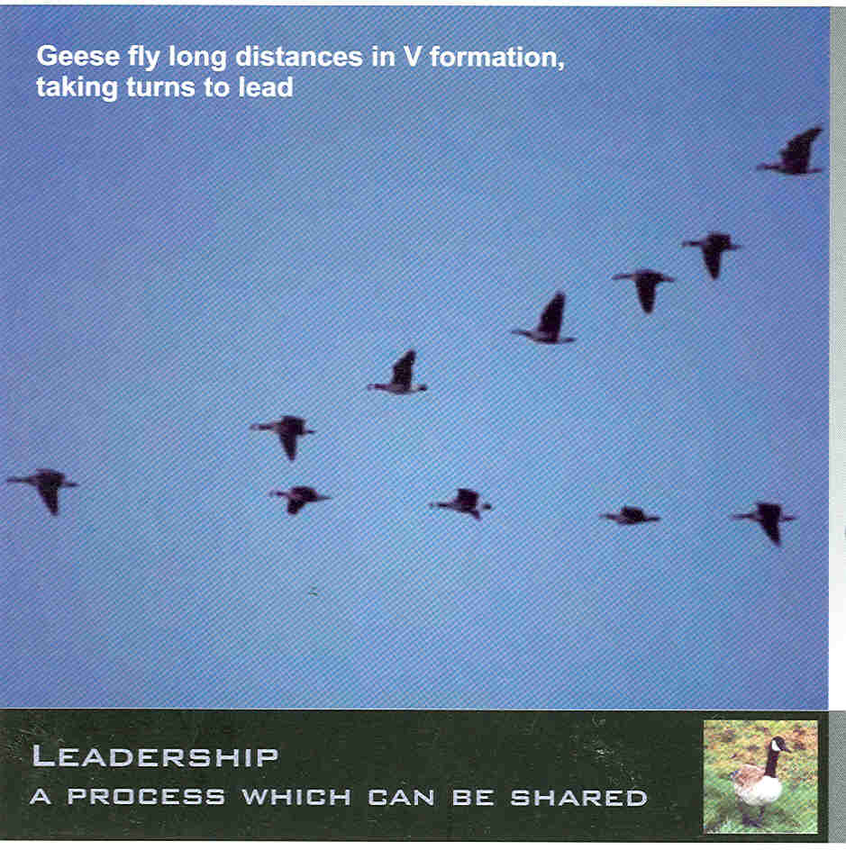

Slide 3


Slide 4
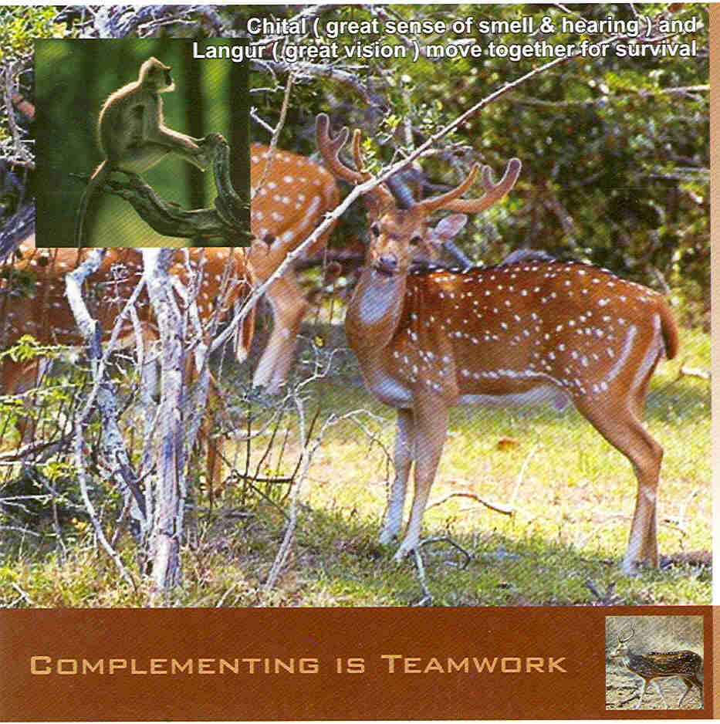

Slide 5


Slide 6


Slide 7


Slide 8


Slide 9


Slide 10


Slide 11
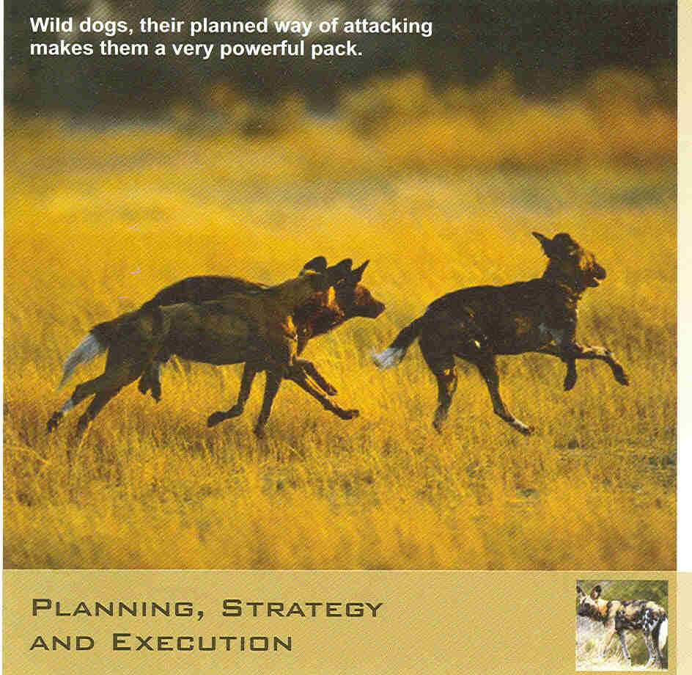

Slide 12


Slide 13
MANAGEMENT
Elements of management
  Planning
  Organising
  Directing
  Co-ordinating
  Controlling
  As propounded by the Management Guru, Peter Drucker
The best way to predict the future
is to create it
- Peter Drucker

Slide 14
MANAGEMENT IN THE JUDICIARY –
MODEL COURT
  Non-value added items – big rocks
  Core competence – specialist Judges/court managers
  Time Management – 80/20 rule/ time frame
  Procedural simplification – codes / rules /moon story
  Paradigm shift – CBI
  De-centralization – Service / Law clerks
  Latest first – Frivolous suits / false defences / snake story
  Sharing best practices – emulating the habits of the most successful persons
  Systemic challenges - Circle of control, influence & concern
  Single (what) / double (why) loop thinking – Goal vs. Task / change task to reach goal / painter, singer story
  Performance related promotions - PRP
  Judicial Social Service – CSR / Legal aid & Legal services
  Continuous education – The National Centre for State Courts, US
  TEAM – Lawyers and Judges / Leadership training
Think Globally …… Act Locally

Slide 15
WHAT IS CASE MANAGEMENT?
Practitioners and Judges becoming better at what they do – i. e.,
Achieving the same end with less resources and in less time.
- Lord Justice Woolf,
Master of the Rolls, UK
How to do
MORE with less
To be a success in any thing –
Be Daring …… Be First …… Be Different

Slide 16
CASE MANAGEMENT - for what?
Improving efficiency
Reducing delays
Cutting costs
Judges who think they are too busy to manage cases are really too busy not to. Indeed, the busiest Judges with the heaviest dockets are the ones most in need of sound case management practices.
- William Schwarzer

Slide 17
Lord Woolf Report
Basic Features
Procedural simplicity for expedition
Control by Judges as soon as defence filed
Peculiar to England
Costs
Expert witnesses
Unlimited Legal Aid
The best way out is always through.
– Robert Frost

Slide 18
Lord Woolf Report - Applicability
England
Simple Rules
Defence
Exchanging Witness statements
Small claims / Fast Track / Multi Track
Specialist Judges
Fixed Fees either for one stage or as a whole
ADR – A M C
Capping of costs
India
Amendment to CPC / HC Rules
WS / Affidavit-in-Reply
Affidavit of examination-in-Chief
Summary suits / Fast Track / Others
Civil / Criminal Judges
Original / Appellate Sides
Package Deal
ADR – A M C & Lok Adalat
Imposing realistic costs
If there is a path, I’ll find it;
If there is no path, I’ll make it.
- Alexander

Slide 19
CASE MANAGEMENT

Slide 20
Ambit of Case Management
Procedural
Substantive
Infrastructure
Sensitivity
requiring
Human mind is like a parachute;
It works only when it is open

Slide 21
STAGES OF CASE MANAGEMENT
Service
Interim Applications
Ad-Interim relief
Salutary provisions (O7/R11, O10/R1, O12/R6, O13/R1(3), O14/R2, O15/R1&3, O18/R1)
Court Commissioners
Oral applications
Most geniuses prosper not by deconstructing intricate complexities,
but by exploiting unrecognized simplicities.

Slide 22
STAGES OF CASE MANAGEMENT (Contd…)
Written Statement
Original documents
Preliminary Decree
Issues
Admissions
Evidence
Compilation
Get not only the best from the best,
But the most from the least.

Slide 23
STAGES OF CASE MANAGEMENT (Contd…)
Arguments
Precedents (settled principles of law)
Judgment
Judgment on Arguments (Summary Judgment)
Costs
ADR
Summary Suits (Small claims)
Successful people do not do different things,
They do things differently.

Slide 24
COURT MANAGEMENT

Slide 25
ASPECTS OF COURT MANAGEMENT
Valuation (Court fees)
Scrutiny
Technicalities
Directions
Certified Copies
Group matters
New Suits
Case tracking
Expedition Orders
If rascals knew the value of honesty and fair dealing;
They’d be honest and deal fairly.

Slide 26
ASPECTS OF COURT MANAGEMENT (Contd…)
Discharge of Suits on Board
Classification of Suits
Registrar’s Powers
Time accountancy (performance standards - balance sheet of cases)
Amendment of Statutes regarding notice – s.80, s.527, s.164
It’s not the load that breaks you down;
It’s the way you carry it.

Slide 27
REQUIREMENTS FOR EFFECTIVE MANAGEMENT
Amendment to Orders in the CPC by the High Courts (CPC)
High Court Practice Directions (HCPD)
Judicial Training (JT)
Precedents
Court Administration (CA)
Courts sitting with one eye open on law and
one eye closed on society – Justice Krishna Iyer

Slide 28
DOCKET MANAGEMENT

Slide 29
ASPECTS OF DOCKET MANAGEMENT
Service
Written Statement
Directions
Case tracking
Expedition orders
Discharge of board
Classification
Delegation of Powers
If we do not let the world teach us, it teaches us a lesson

Slide 30
The best 10 two-letter words –
If it is to be,
It is up to me.

